Slide 1
Medical Image Analysis of Pneumothorax
Vivek sai Perikala
ED16B019

Slide 2
Contents
Motivation
Objective
Datasets
Preprocessing
Approach
Segmentation
Classification
Results
Future Outlook

Slide 3
Motivation
WHY?
Imagine suddenly gasping for air, helplessly breathless for no apparent reason. Could it be a collapsed lung?
Pneumothorax is a life-threatening clinical condition which may require emergency treatment in Emergency Medicine Departments.
Pneumothorax occurs when air leaks into the space between the lungs and chest wall.
It can be caused by a blunt chest injury, damage from underlying lung disease, or most horrifying—it may occur for no obvious reason at all.
Pneumothorax is usually diagnosed by a radiologist on a chest x-ray, and can sometimes be very difficult to confirm. This is the problem I strive to find a solution.
An accurate AI algorithm to detect pneumothorax would be useful in a lot of clinical scenarios. AI could be used to triage chest radiographs for priority interpretation, or to provide a more confident diagnosis for non-radiologists.

Slide 4
Objective
What?
Develop an AI model to classify (and if present, segment) pneumothorax from a set of chest radiographic images.
It could aid in the early recognition of pneumothorax and can save millions of lives.

Slide 5
Datasets
The data is comprised chest radiograph images in DICOM format and annotations in the form of image IDs and run-length-encoded (RLE) masks.
Some of the images contain instances of pneumothorax (collapsed lung), which are indicated by encoded binary masks in the annotations. Some training images have multiple annotations.
Images without pneumothorax have a mask value of -1.
Image ID | Mask value
1.2.276.0.7230010.3.1.4.8323329.14508.1517875252.443873 | 387620 23 996 33 986 43 977 51 968 58 962 65 956 70 952 74 949 76 946 79
1.2.276.0.7230010.3.1.4.8323329.1034.1517875166.8504 | -1

Slide 6
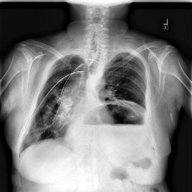
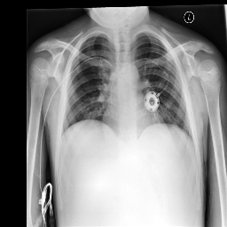
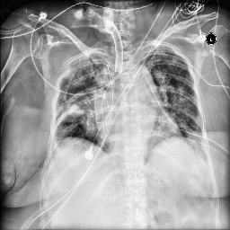
Sample training images:

Slide 7
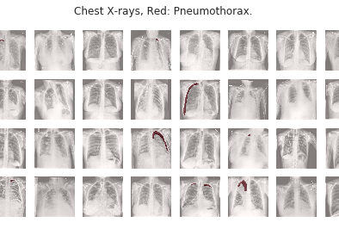
Training set images with Masks

Slide 8
Preprocessing
Images of size 1024x1024 converted to 256x256
Applied image normalization based on histograms, that provides some improvement of image appearance as well as a small boost of the model performance.
Training images and validation images are divided into 80% and 20% respectively

Slide 9
Preprocessing
Problem: 78% masks are empty
I used different augmentation techniques to overcome this imbalance problem
Various augmentations include:
RandomBrightness, RandomContrast, RandomGamma
RandomSizedCrop
OpticalDistortion
HorizontalFlip
GridDistortion
ElasticTransform

Slide 10
Approach
Segmentation
Unet++
Used UNet++ which consists of pre-trained EfficientNetB4 as encoder and Residual blocks in the decoder part
Unet++ introduces intermediate layers to skip connections of U-Net, which naturally form multiple new up-sampling paths from different depths, ensembling U-Nets of various receptive fields

Slide 11
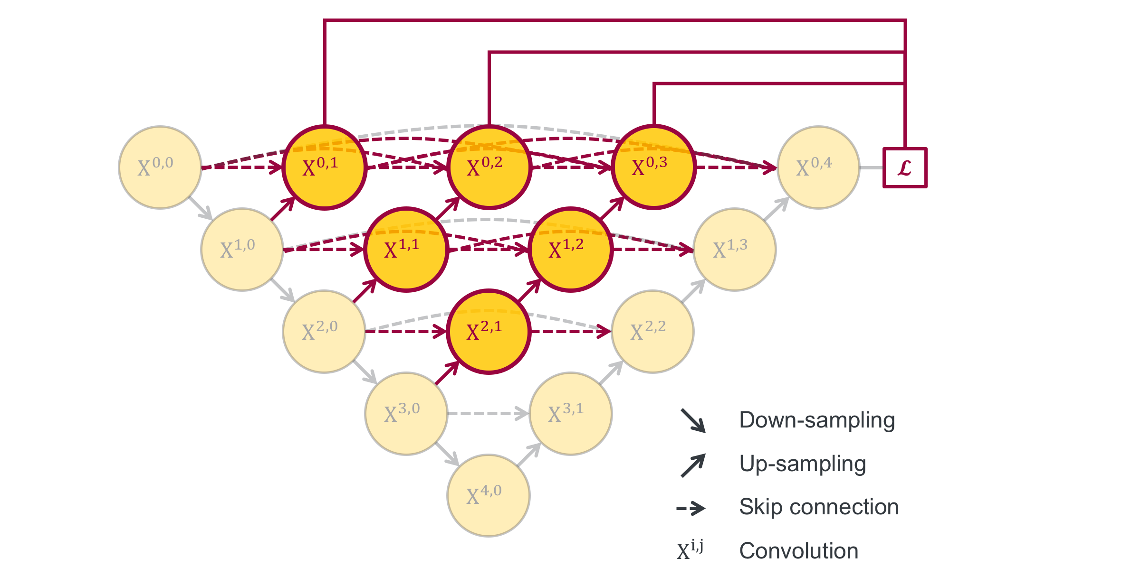
UNet ++

Slide 12
Continued...
This model results in far better performance than traditional Unet
Used Stochastic Weight Averaging for optimization of results that averages multiple points along the trajectory of SGD, with a constant learning rate.

Slide 13
Fastai model
Built Unet like architecture with ResNet34 based pretrained encoder
Used:
Hypercolumns
Gradient accumulation
TTA based on horizontal flip
Noise removal (if the predicted mask contains too few pixels, it is assumed to be empty)
Image equilibration

Slide 14
Fastai model is modified to incorporate Hypercolumns
Each upscaling block is connected to the output layer through linear resize to the original image size. So the final image is produced based on concatenation of U-net output with resized outputs of intermediate layers. These skip-connections provide a shortcut for gradient flow improving model performance and convergence speed.
Since intermediate layers have many channels, their upscaling and use as an input for the final layer would introduce a significant overhead in terms the computational time and memory. Therefore, 3x3 convolutions are applied (factorization) before the resize to reduce the number of channels.
Used accumulation of gradients to overcome the problem of too small batches.

Slide 15
Mask RCNN
It’s a combination of Faster RCNN and FCN
Faster R-CNN first uses a ConvNet to extract feature maps from the images
These feature maps are then passed through a Region Proposal Network (RPN) which returns the candidate bounding boxes
We then apply an RoI pooling layer on these candidate bounding boxes to bring all the candidates to the same size
And the proposals are passed to a fully connected layer to classify and give the bounding boxes for objects
And finally, they are sent to Fully Convolutional Network (FCN) and outputs the desired segmentations

Slide 16
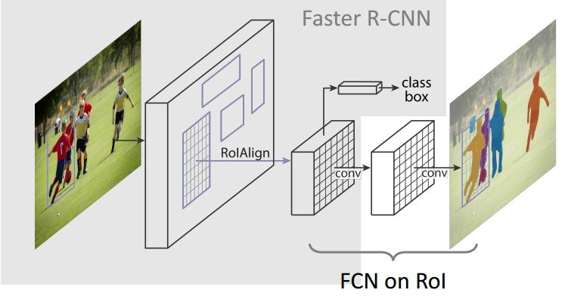

Slide 17
Classification
Vision Transformers
Here we are breaking down the image into fixed size patches. Treats images as “16x16 words".
The patches are then unrolled (flattened) and sent for further processing into the network.
Unlike NNs here the model has no idea whatsoever about the position of the samples in the sequence, here each sample is a patch from the input image.

Slide 18


Slide 19
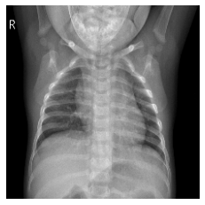
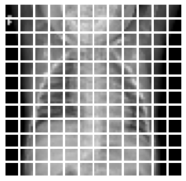

Slide 20
Segmentation Results Results of Unet++
S.No | ImageID | EncodedPixels
3195 | ID_510e7b502 | -1
3196 | ID_c08647bca | -1
3197 | ID_ec436eb1c | -1
3198 | ID_92c6dd254 | 535685 2 1019 8 1012 16 1006 18 1004 20 1003 2...
3199 | ID_181d9fb2a | 336078 5 1015 12 1007 17 1006 18 1004 20 1002 ...
3200 | ID_f4f13fb70 | -1
3201 | ID_ac7edbe80 | 607493 2 1013 14 1 4 998 27 995 30 987 41 978 ...
3202 | ID_e6c7ff1df | -1
3203 | ID_c54c3e5de | -1
3204 | ID_c832ccaba | 182611 5 1014 12 1010 17 1004 21 1000 24 999 2...

Slide 21
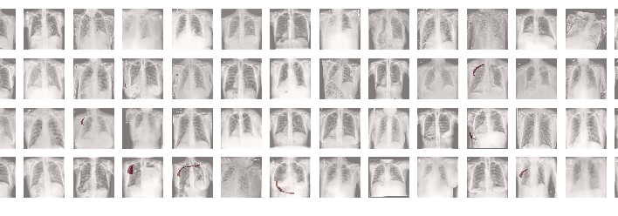
Test set predictions of Unet++

Slide 22
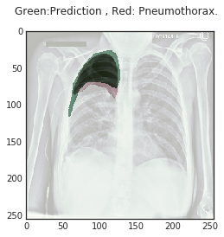
Predictions of Unet++

Slide 23
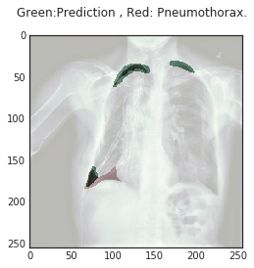
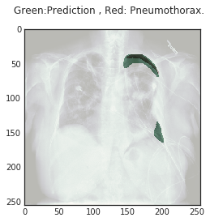
Predictions of UNet++

Slide 24
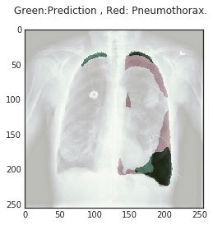
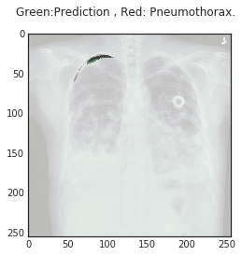
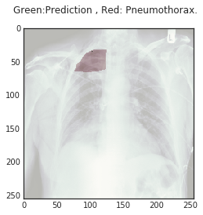
Predictions of Unet++

Slide 25
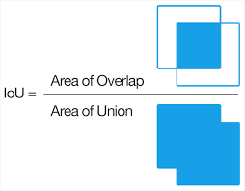
Loss Functions and Metrics
Iou as loss function :
Instead of accuracy as metric, we use IoU score to generalize our model for segmentation tasks.

Slide 26
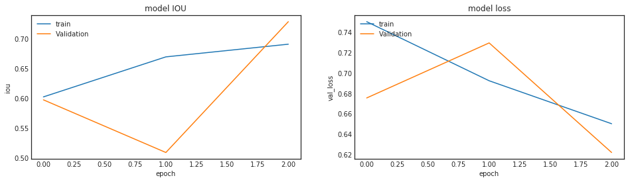
Plots of Unet++
Epochs: 4

Slide 27
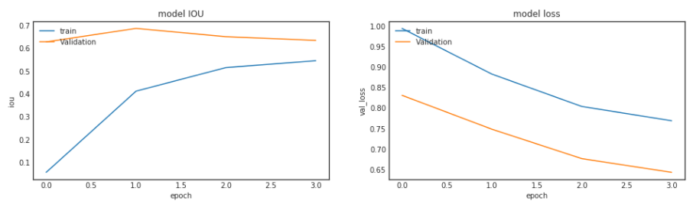
Plots of Unet++
Epochs: 5

Slide 28
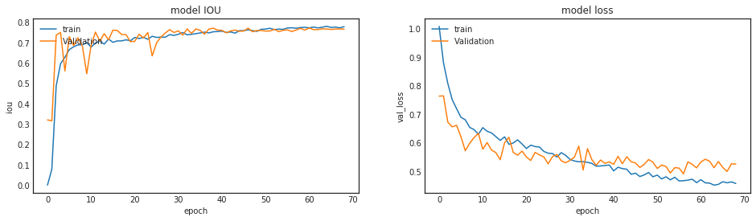
Plots of Unet++
Epochs: 70

Slide 29
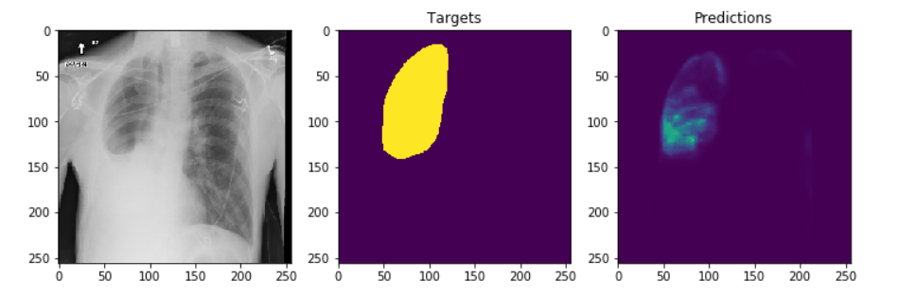
Predictions using Fastai model
Results of Fastai model

Slide 30
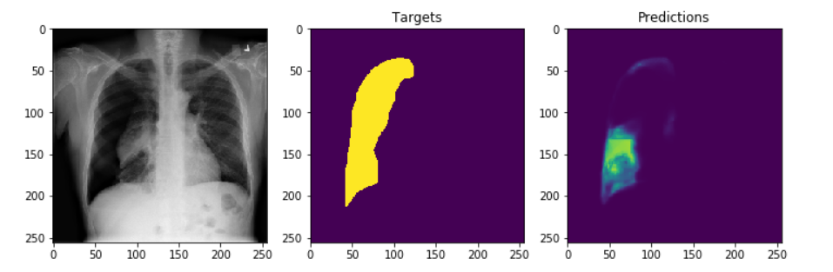
Predictions using Fastai model

Slide 31
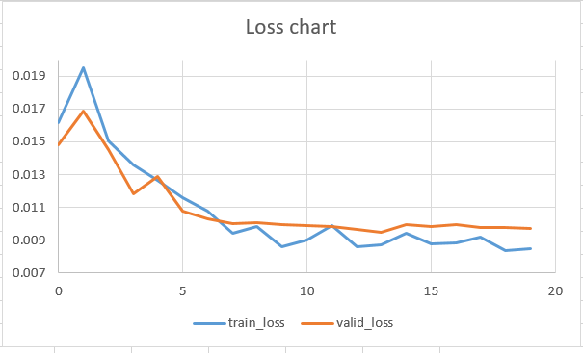
Loss Plots of Fastai model

Slide 32
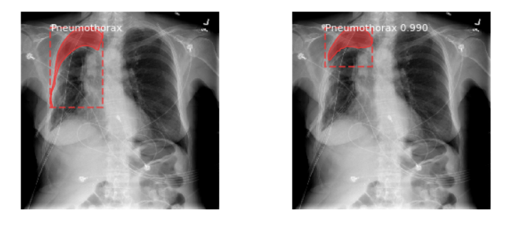
Predictions of Mask-RCNN
Results of Mask-RCNN
Ground truth Prediction

Slide 33
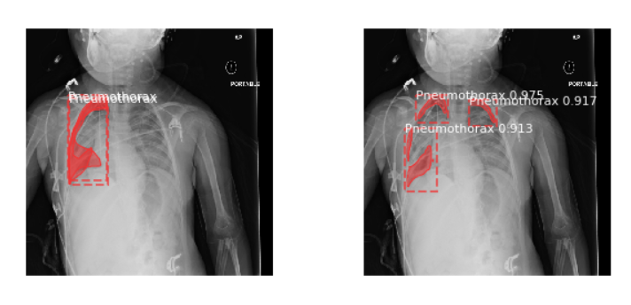
Predictions of Mask-RCNN
Ground truth Prediction

Slide 34
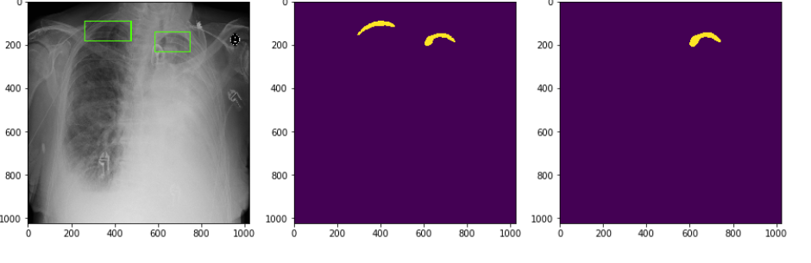
Mask view on prediction
Original Image Ground truth mask Prediction mask

Slide 35
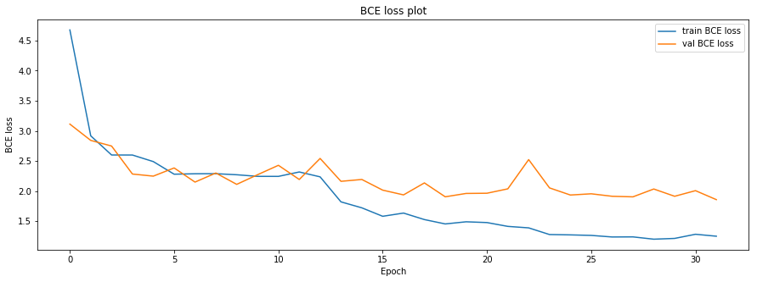
Loss plots of Mask-RCNN

Slide 36
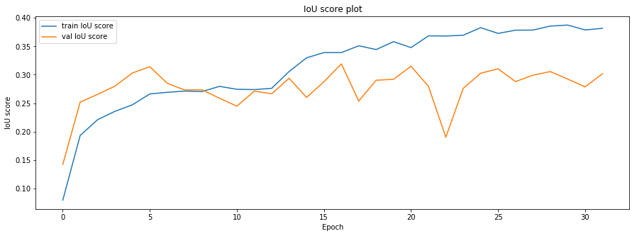
IOU plots of Mask-RCNN

Slide 37
Comparison of IoU Values of Segmentation models
Segmentation Model | IoU
UNet++ | 0.78
Masked-RCNN | 0.62
UNet (with Hypercolumns) | 0.4

Slide 38
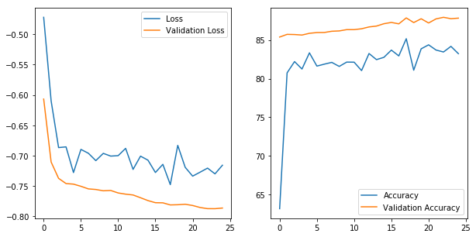
Classification Results
Vision transformer model:
Achieved 92% accuracy

Slide 39
Future outlook
Experiment with more state of the art algorithms and tuning the hyperparameters could improve the model further
Inferences from our pipeline can also be used to integrate medical professionals into the learning process by providing them with information about the internals of the model in a form that they can understand

Slide 40
References
UNet++: A Nested U-Net Architecture for Medical Image Segmentation, Zongwei Zhou, Md Mahfuzur Rahman Siddiquee, Nima Tajbakhsh, Jianming Liang
UNet++: Redesigning Skip Connections to Exploit Multiscale Features in Image Segmentation, Zongwei Zhou, Md Mahfuzur Rahman Siddiquee, Nima Tajbakhsh, Jianming Liang
Gonzalez, R. C. and R. E. Woods (2007). Image processing, Volume 2
Sharma, N. and L. M. Aggarwal (2010). Automated medical image segmentation techniques . Journal of medical physics/Association of Medical Physicists of India 35 (1), 3.

Slide 41
Thank you

